Slide 1




DATA SCIENCE PROJECT
SOLAR POWER
GENERATION

Slide 2




Meet Our Team
GROUP MEMBERS:-
1) Aswin E V
2) Sairam Podishetti
3) Roshni
4) Lohit Hoolageri
5) Samrat Jha
6) Rathna Reddy Hiregowdar
Mentor :- Dilavar Basha
Co-Mentor :- Sunkarapelli Mounika

Slide 3

PROBLEM STATEMENT
To accurately predict the amount of solar energy produced (power generation) based on various environmental and meteorological conditions.
Challenges in Applying machine learning to Solar Power generation Detection
Handling Multicollinearity and Feature Relevance
Capturing Non-Linear Environmental Dynamics
Mitigating Overfitting within Tight Timelines

Slide 4

Project Objective
The main objective of this project is to build a regression model that predicts the continuous value of energy production (power generated) using various environmental variables. The dataset "solarpowergeneration.csv" contains 10 features and 2920 rows, with columns like distance to solar noon, temperature, wind direction, wind speed, sky cover, visibility, humidity, average wind speed, and average pressure. The target variable is power generated, measured in Joules for every 3-hour interval.
The objective is to accurately model and predict solar energy production as a function of environmental and meteorological variables, supporting efficient energy planning, grid stability, and resource optimization in solar power plant .operations

Slide 5




01
EDA AND DATA CLEANING

Slide 6
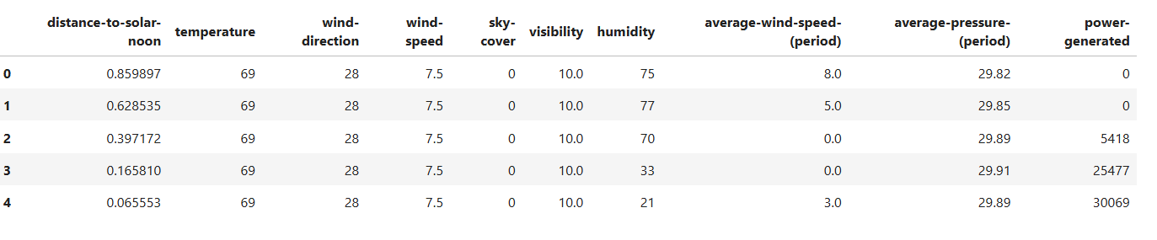
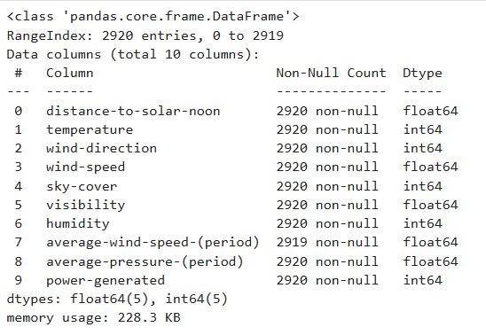
Exploratory Data Analysis
Objective :- Analyze dataset patterns, trends, and relationships to guide informed modeling decisions
Steps Taken
1) Imported Necessary Libraries:-
Pandas, NumPy -> Data handling
matplotlib, seaborn -> visualization
2) Explored Dataset Structure:-
Verified column names and confirmed shape
(2920 rows x 10 columns)
3) Initial Observations:-
Explored summary statistics ( mean, median, min, max, etc)
Checked for duplicate rows and found none
Verified data types of columns to understand numerical and categorical features
and found out there were no categorical features

Slide 7
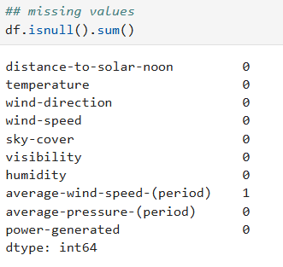
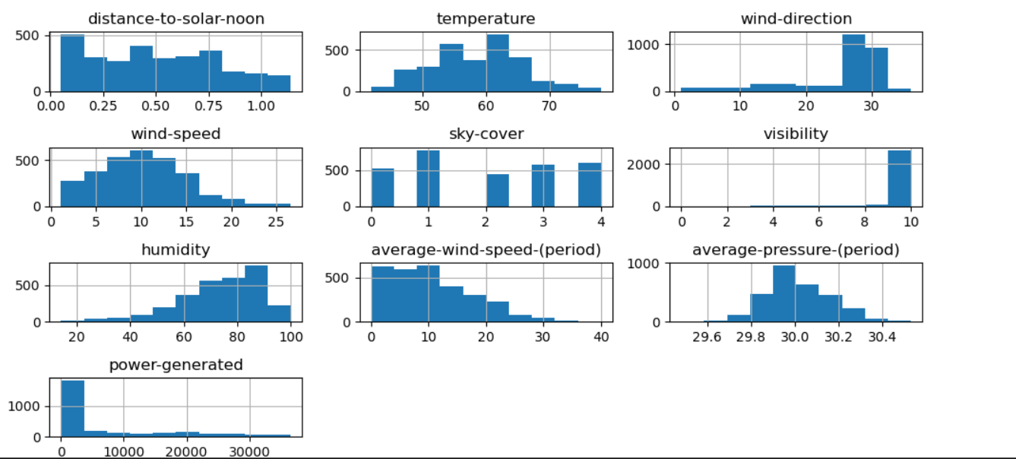
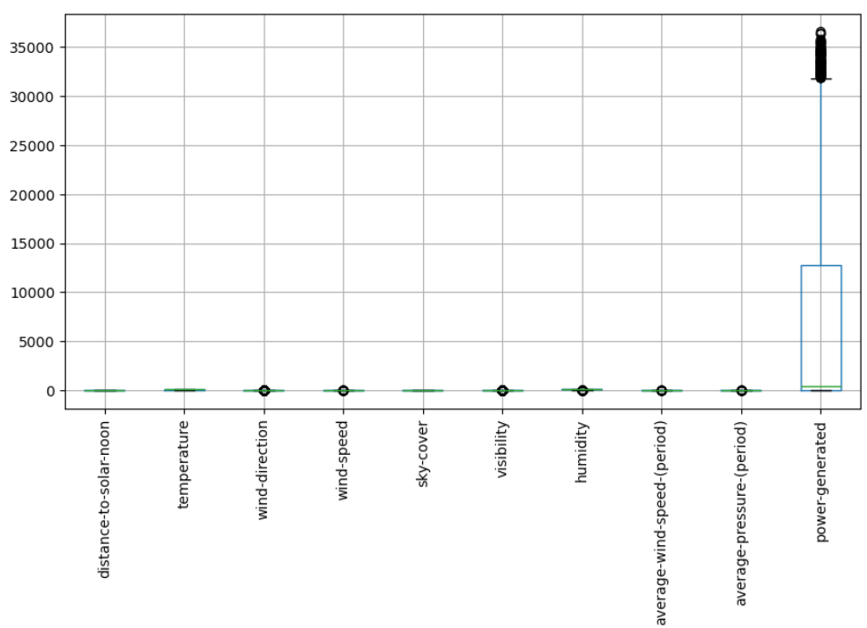
Checked for missing values and found 1 missing value in average-wind-speed(period) column.
4) Visual Insights from EDA:-
Histogram for all features were generated along with kde plot to observe how each feature helps
in determining the power generated.
Identified outliers in most of the columns (wind-direction, wind-speed, visibility, etc using box plot

Slide 8
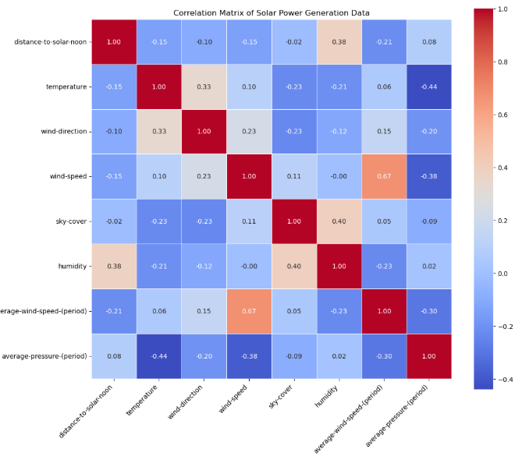
We have also plotted a heatmap to show the correlation of every features and here are the observations we found:-
The most significant insight is that geometric and atmospheric obstructions to light are the primary drivers of power generation, far outweighing wind or pressure.
Through your VIF (Variance Inflation Factor) analysis and
correlation heatmaps, you identified that not all atmospheric
data adds value.
You found that visibility had high multicollinearity with other
features and a low unique relationship with power-generated

Slide 9
DATA CLEANING & PREPROCESSING
Objective :- To ensure the dataset is accurate, complete and ready for machine learning models
Steps Taken :-
1) Missing Value Verification :-
Checked all 10 columns for missing values using null value analysis and one missing value was found.
Since the percentage of missing values was below 5%, the row was deleted.
2) Duplicate Data Check :-
Verified whether there were any duplicate records in the dataset.
No duplicate entries were found , confirming that all the 2920 rows were unique.
3) Data Type Validation :-
It was found that all the columns given in the dataset were unique.
Hence we confirmed that it was a regression project.

Slide 10
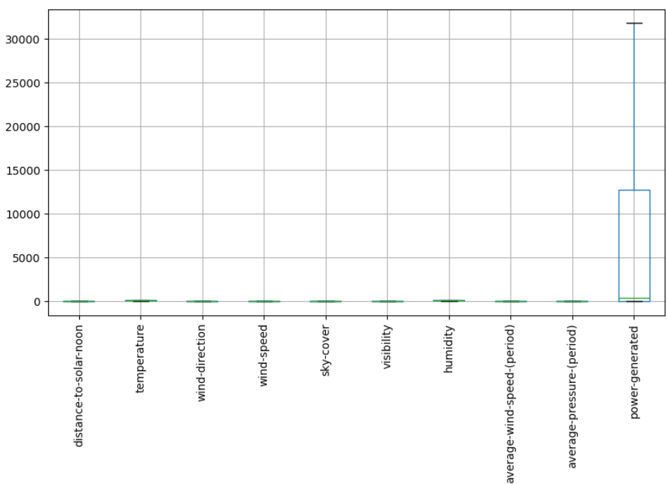
4) Outlier Detection & Treatment :-
Used boxplots to visually detect extreme values in each of the features given
Outliers were found in most of the columns such as wind-direction, wind-speed,
visibility etc and they were capped to the extreme values.
5) Feature Dependency
We calculated the f-regression score and found out that the target column is
less dependent on visibility and average-pressure-(period).
We also found out that the VIF score of visibility is so high.
So we are removing the visibility column as it is not following the conditions.
6) Correlation Matrix:-
This analysis confirms that solar power generation is primarily driven by the time of day (distance to solar noon) and
atmospheric conditions (sky cover and humidity)

Slide 11

02
MODEL BUILDING AND EVALUATION

Slide 12

MODEL BUILDING
Objective :- To develop and compare multiple machine learning models that can accurately predict the power generated using the atmospheric and the geographical features given to us.
Steps Taken :-
1) Train-Test Split :-
We divided our dataset into two distinct sets: Training (80%) and Testing (20%).
This ensures that the model is evaluated on "unseen" data. It is the primary defense against Overfitting, where a model performs perfectly on known data but fails in real-world applications.
We utilized a fixed seed (random state=42) for the shuffling process.
2) Preprocessing :-
We used two separate StandardScaler objects: one for our Features (std_sca) and one for our Target variable (std_sca_target).

Slide 13
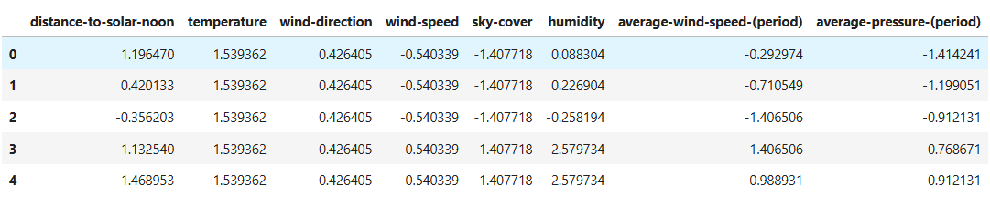
Scaling transforms all values to have a Mean of 0 and a Standard Deviation of 1.
Scaling is essential for algorithms like Gradient Boosting and Linear Regression.
It helps the model's optimization process (gradient descent) converge much faster. By bringing all features to a similar scale, the model can find the "mathematical sweet spot" for predictions more efficiently and accurately.
3) Model Development :-
Five machine learning models are developed using pipelines :-
Linear Regression
Ridge Regression
Support Vector Regression
Random Forest Regressor
Gradient Boosting Regressor
Each model receives :-
Same Training data which is standardized.
Same preprocessing Pipeline

Slide 14
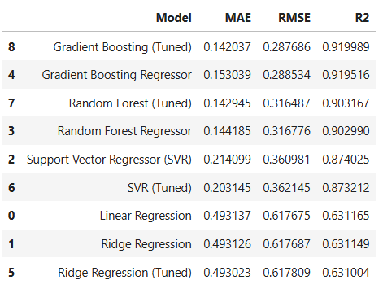
4) Hyperparameter Tuning & Model Selection :-
GridSearchCV with 5-fold cross validation
Evaluation metric :- RMSE and R2 Score
Models Tuned :-
Support Vector Regressor
Random Forest Regressor
Gradient Boosting Regressor
Best model selected based on highest R2 Score and lowest RMSE.
5) Final Model Evaluation and Comparison
All 5 models evaluated on the unseen test data
Metrics used :-
Mean Absolute Error (MAE)
Root Mean Square Error (RMSE)
R2 Score

Slide 15
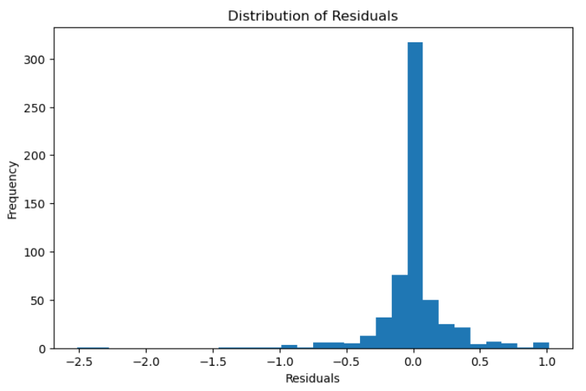
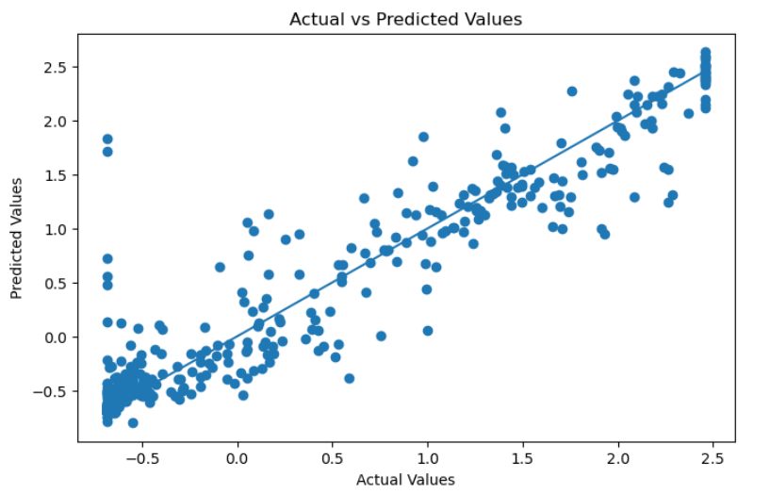
Additional Visualization:-
We have plotted the Distribution of residuals and the Actual v/s Predicted values of the best model.

Slide 16
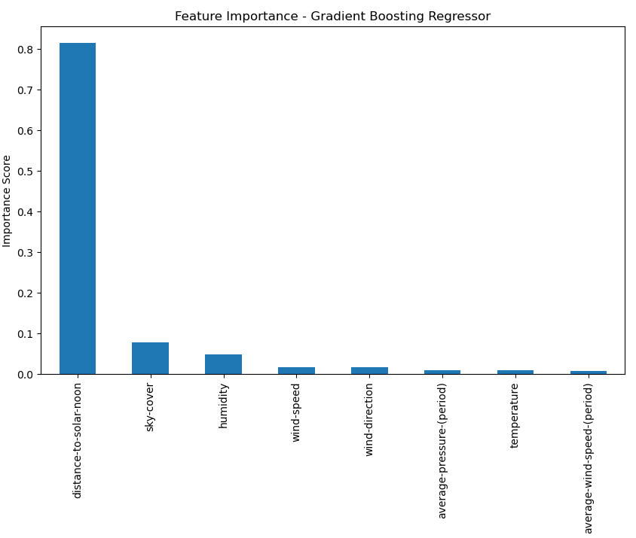
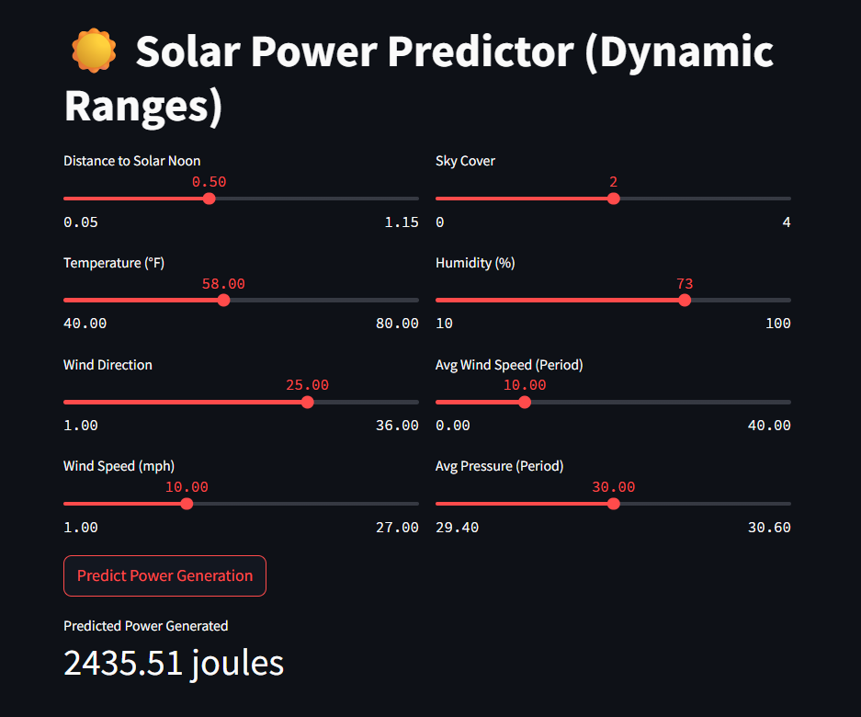
7) Final Model Selection & Saving :-
Gradient Boosting Regressor achieved low RMSE value and high R2 Score.
So chosen as the Final Model.
Entire preprocessing + Model pipeline saved as
“gbr_model.pkl”
Model is deployment Ready

Slide 17
PROJECT SUMMARY & KEY FINDINGS
This project aims to build a high-precision machine learning model to predict solar energy production based on atmospheric and environmental data’
Solar energy is highly volatile and dependent on chaotic weather patterns. The objective was to develop a Regression model capable of predicting the power-generated (in Joules) for 3-hour intervals using 8 key meteorological features.
The dataset consisted of 2,920 instances and 10 columns with power-generated as the target.
Identified strong negative correlations between solar noon distance/sky cover and power output after conducting EDA.
Conducted VIF (Variance Inflation Factor) analysis and removed the visibility feature due to high multicollinearity and low predictive significance.
Utilized StandardScaler to normalize features and the target variable, ensuring all inputs were weighted fairly by the model.
Multiple models were tested, including Linear Regression and Ridge Regression, but the Gradient Boosting Regressor was selected as the final model.
The project was deployed using the Streamlit framework, creating an interactive web application.

Slide 18

Thank
you!

